Slide 1
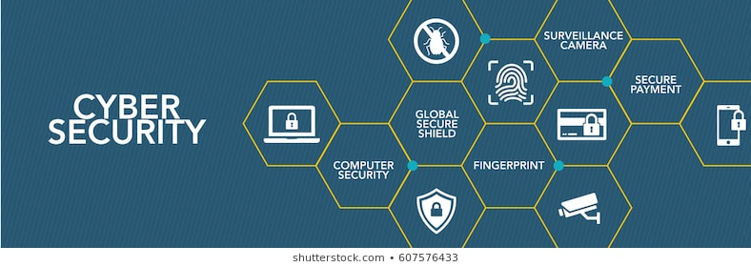
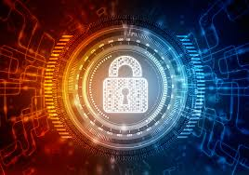
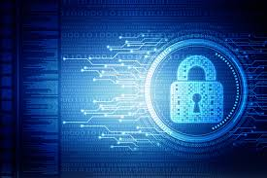

Slide 2
Presentation on IT Fundamentals of Cyber Security
Introduction to cybersecurity tools and cyber attack
Cybersecurity roles, processes and operating system security
Cybersecurity compliance, Framework and system administration
Network security and Database
(Duration:-71 hours(Beginners level))
(Submitted by:-Tanishk Jharwal)
Submitted to:-Mrs. Kavita Jain

Slide 3
Content
Introduction
Categories of Cyber crime
Types of Cyber crime
Types of Security tools
Advantage of Cybersecurity
Safety tips to Cyber crime
References

Slide 23
Types of Security Tools

Slide 30
Wireshark

Slide 33
N-Map

Slide 34
Features

Slide 36
Nessus

Slide 38
Features

Slide 43
References
www.Wikipedia.org
www.avtest.org
www.billmullins.blogspot.com
www.digit/forum.com
www.antivirusnews.com

